Slide 1
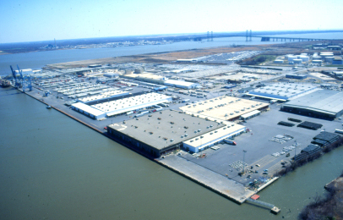
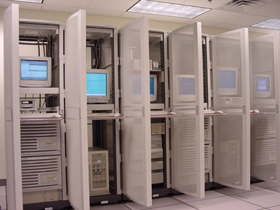
DSPC’S Data Warehouse

Slide 2

Information = Gold
Where to pan?
Where not to?
What is the keystone?
Notes:
Samuel Bacon 360 years ago said Knowledge is Power.
A crucial component of knowledge is information.
Where should we be panning?
Where not to?
How pure is the gold?
This is a nice way to think about it.
On the Pacific Rim business is war. We in America have such a penchant for being nice.
In war, the number one thing is to know your terrain. What are you working with?
Don’t fly without instruments!

Slide 3
Top 10
  How many ships should a shipper ship if a shipper should ship some ships …. In September?
  What color is the cargo?
  Is it all growing or shrinking?
  How many tables do we help set?
  Do they have us ‘over’ the barrel in over time?
  What’s odd about April?
  When do most thumbs twiddle?
  How big are the big dogs, really?
  Who paying their way?
  Where did we lose our shirt?

Slide 4
Top 10
  Berth Utilization
  Cargo Volumes by Commodity / Line of Business
  Volume YTD/MTD Comparisons
  Labor Hire Statistics
  Straight vs. OT
  Resource Scheduling during peak months.
  Efficiency.
  Customer history.
  Receivables.
  P&L

Slide 5



Strategy vs. Operations
X
√
Notes:
Twinkling vs. Non.
Get out of the wheel.
Cogs & how they turn.
Which one is broken?

Slide 6

C-L-R AXES
CARGO-LABOR-REVENUE
Notes:
Twinkling vs. Non.
Not in the wheel
Cogs & how they turn.
Which one is broken?

Slide 7
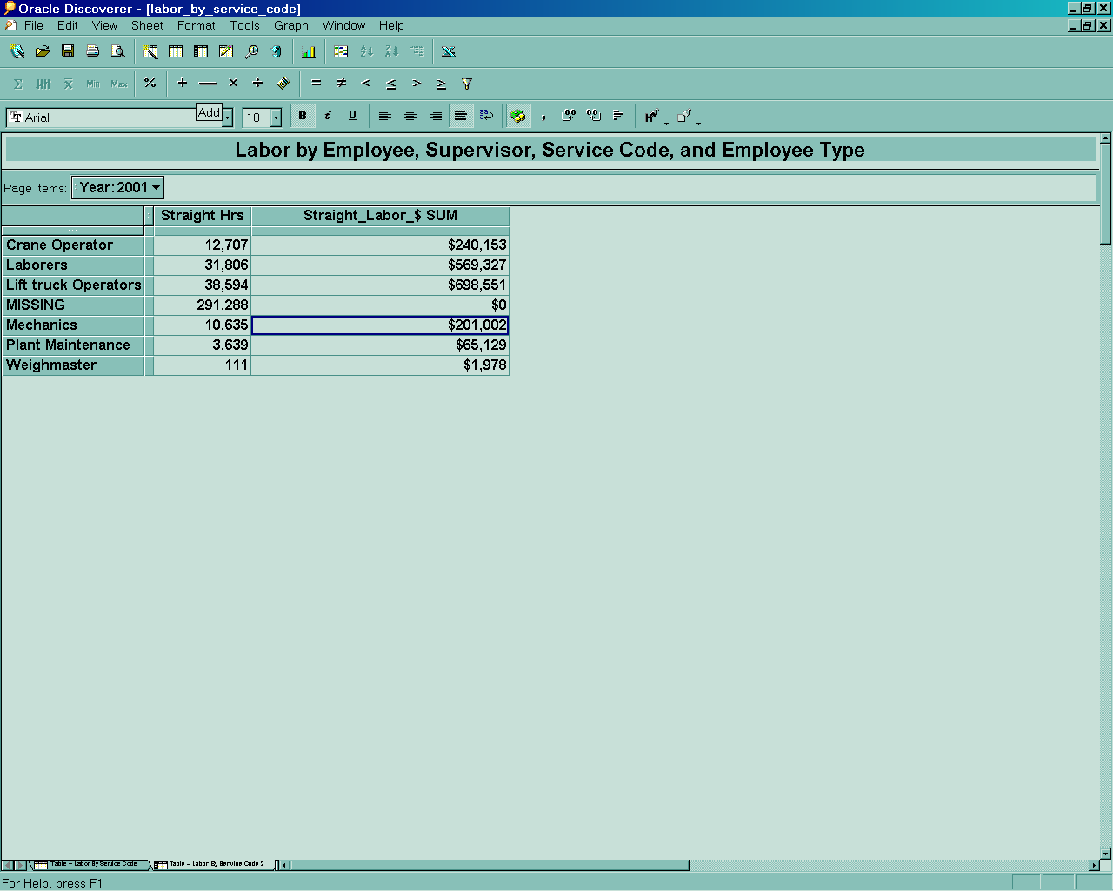
SAMPLE

Slide 8
CARGO
Customer
Time
Date
Month
Week
Quarter
Year
Cargo Volume
Exporter
Shipping Line
Agent
Receiver
Owner
Ship To
Primary Count
Second Unit
Tonnage
Location
Commodity
Discharge Berth
FPR
Storage Location
Type
Group
Contract
Origin
Notes:
The four W’s: When, Who, Where & What?

Slide 9
LABOR
Service
Time
Type
Category
LABOR HOURS
Hour
Date
Month
Week
Quarter
Year
Straight Time
Over Time
Double Time
Other
Hire
CARGO
Supervisor
Employee
Name
Manager
Department
Name
Classification
Union Status
Notes:
The four W’s: Who? What? When? Why?

Slide 10
REVENUE (and Costs)
Time
Service
Revenue (and Costs)
Hour
Date
Month
Week
Quarter
Year
Type
Category
Billed Amount
Paid Amount
Bad Debt
Costs
Profit (Loss)
CARGO
Customer
Name
Contact
Phone
Address
Country
LABOR
Notes:
The four W’s: Who? What? When? Why?

Slide 11
Next Steps?
Each one gives their top three questions/reports.
Any other dimensions to capture?
Put a plan together
Review
Training
Rollout

